Slide 1
Probability Chapter # 2
Observation
Experiment

Slide 2
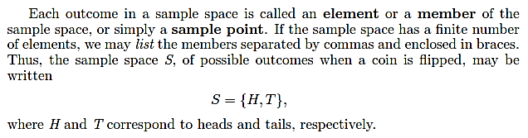
Sample Space

Slide 4
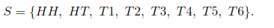
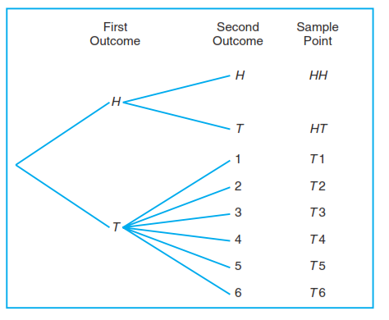

Slide 5
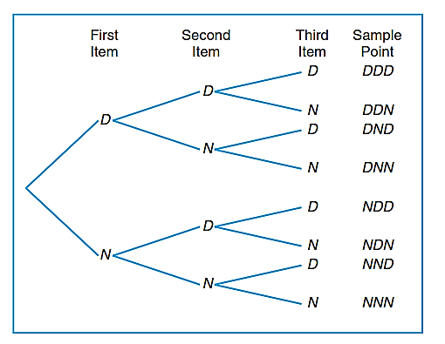

Slide 6
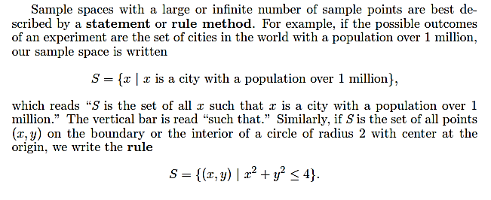

Slide 8
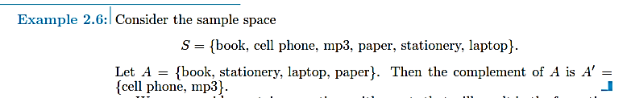

Slide 9
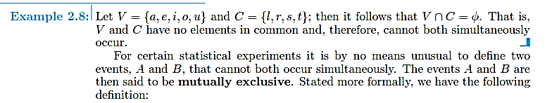

Slide 11
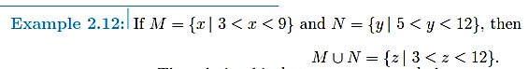

Slide 12
Exercise 2.1-2.16

Slide 13
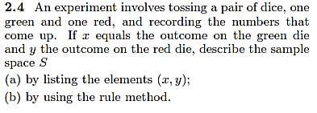

Slide 14
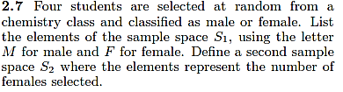

Slide 15
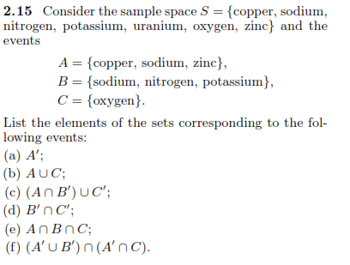

Slide 16
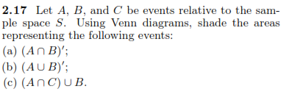

Slide 17
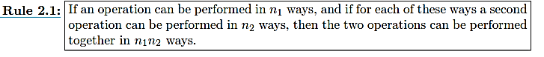
Counting Sample Points

Slide 18
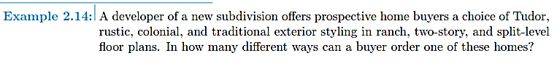

Slide 19
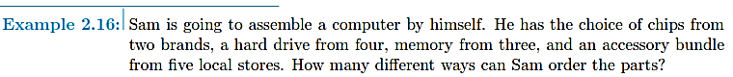

Slide 21
Q) How many four-digit number can be formed from the digit 1, 2, 4, 5, 6 & 9. If each digit can be used more than once. (Repetition allowed)
Q) How many four-digit number can be formed from the digit 1, 2, 4, 5, 6 & 9. If each digit can be used only once.

Slide 22
Q) How many five-digit number can be formed from the digit 1, 2, 4, 5, 6 & 0. If each digit can be used only once.

Slide 23
Q) How many four-digit even number can be formed from the digit 1, 2, 4, 5, 6 & 9. If each digit can be used only once.

Slide 24
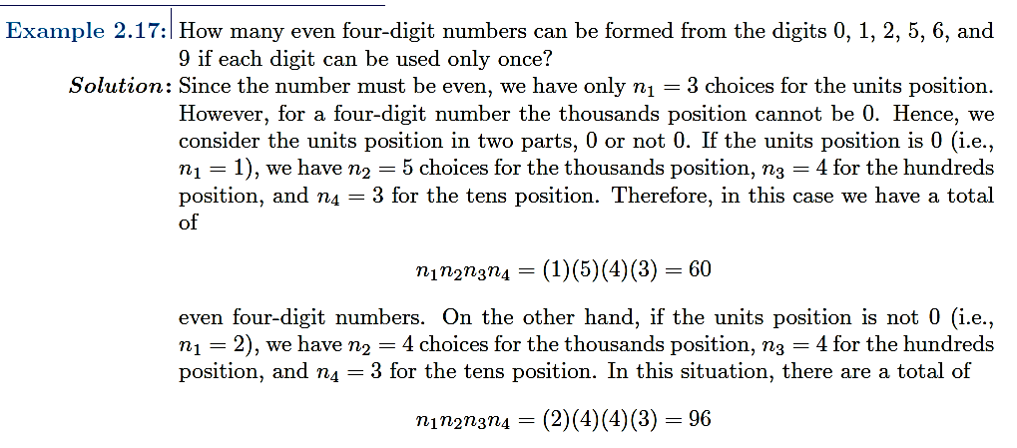

Slide 25
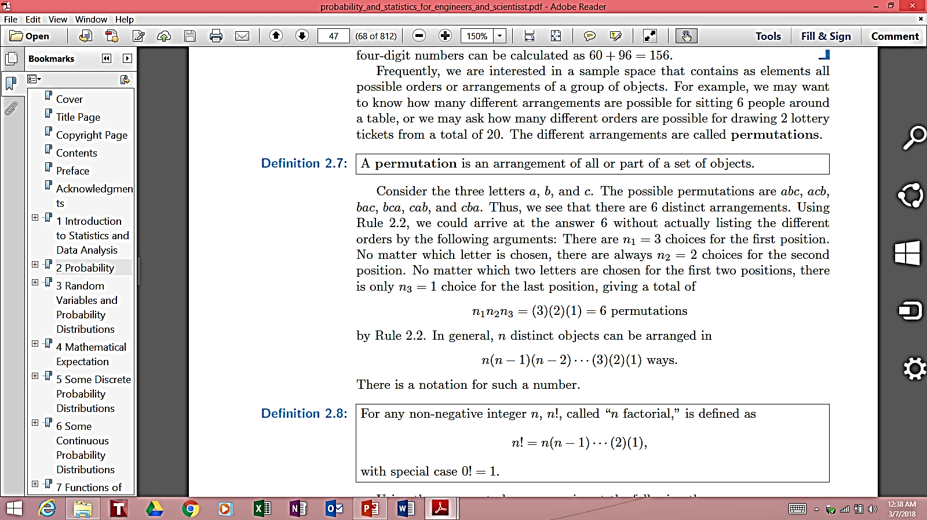
Q) How many five-digit number can be formed from the digit 1, 2, 4, 5, & 6. If each digit can be used only once.

Slide 26
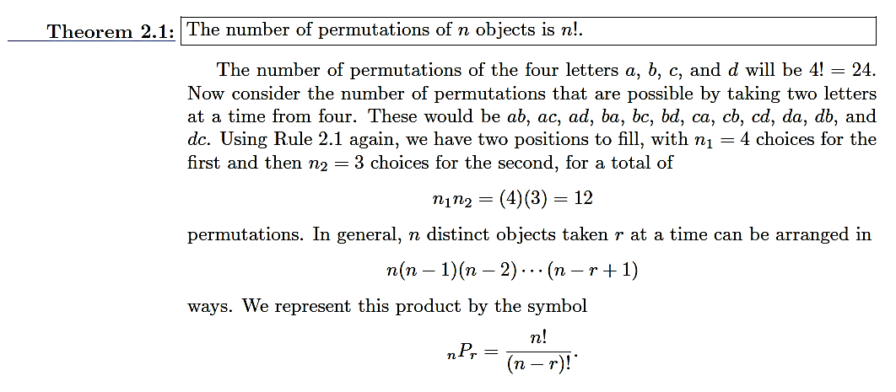

Slide 27
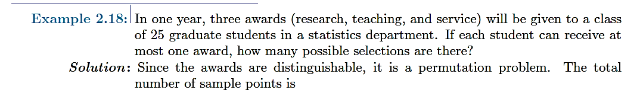
Q) There are 7 members in a committee. How many ways are there to choose a chairman, deputy chairman, secretary and a cash keeper?

Slide 28
Q) A club consists of four members. How many samples points are in the sample space when three officers: president, secretary and treasurer are to be chosen?

Slide 29
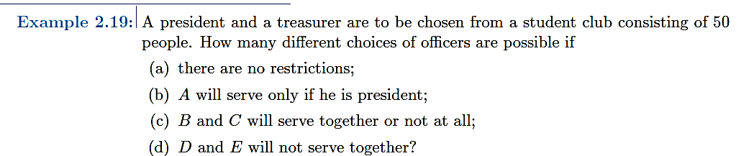

Slide 30
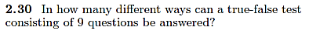

Slide 31
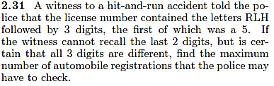

Slide 32
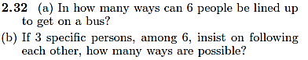

Slide 33
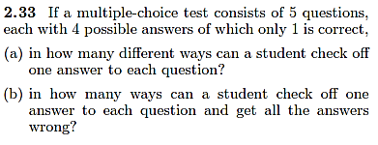

Slide 34
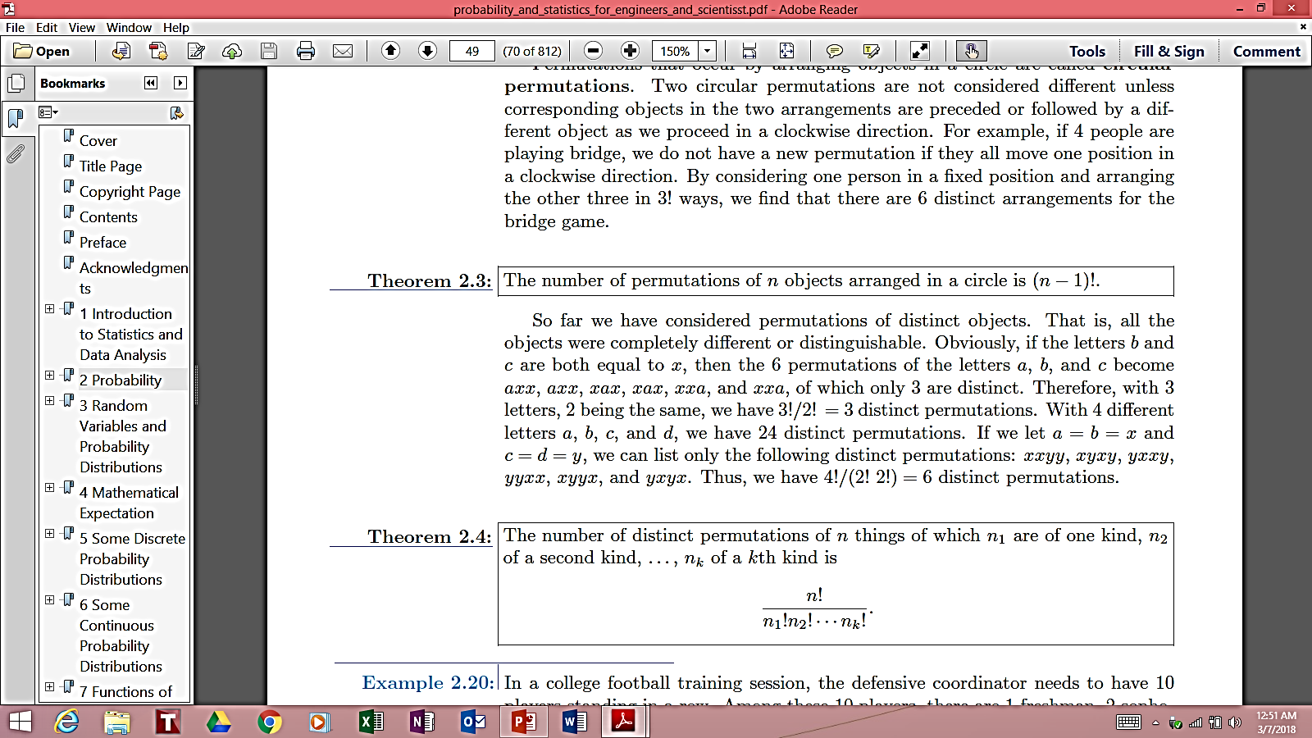
a, b, c

Slide 35
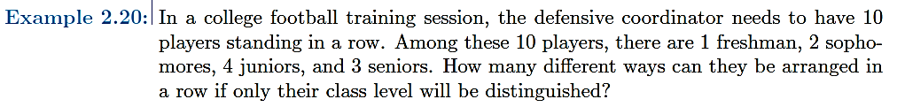

Slide 36
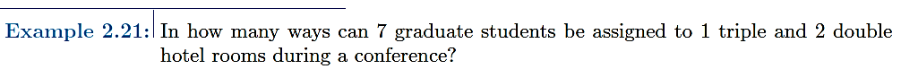

Slide 38
Q) In how many ways a committee of 3 students can be selected from 4 students (A,B,C and D)

Slide 39
Q) In how many ways can the city football team of 11 players be selected from 16 players.

Slide 40
In how many ways can a cricket eleven be chosen out of 14 players if a) A particular student is included b) A particular student is excluded

Slide 41
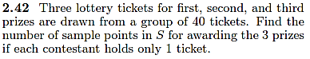

Slide 42
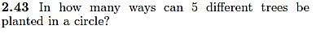

Slide 43
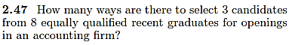

Slide 44
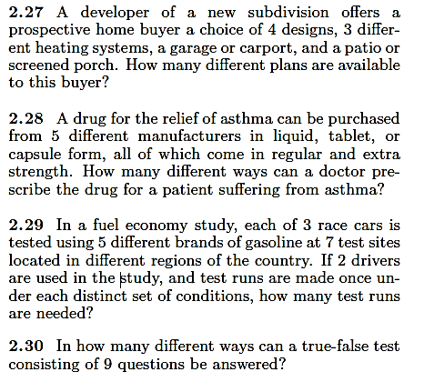

Slide 46
Q From a group of 10 boys and 6 girls a committee of 3 boys and 2 girls is to be selected. In how many ways can this be done?

Slide 47
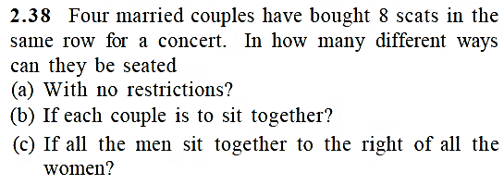

Slide 48
Ex 2.21 – Ex 2.50

